Slide 1
Travel Planner and Cultural Guide: RAG System Development and LLM Comparison
DSCI 6004 01: Natural Language Processing
Team 3: Savyata Regmi
Date: 5/2/2025

Slide 2

Nepal’s Travel Planner & Cultural Guide RAG System
Problem Statement
Travelers planning trips to Nepal often rely on scattered and unstructured information across blogs, forums, and travel guides. It’s difficult to get fast, accurate, and culturally rich answers to basic travel questions especially when planning independently.
Objective
We built a RAG system that answers common travel planning questions about Nepal using grounded and curated text sources with real world usability from food and visa info to budget and trekking routes. We tested the models with 13 domain specific questions.
Why This Matter?
Smart Trip Plan
Cultural Context
AI with Purpose

Slide 3
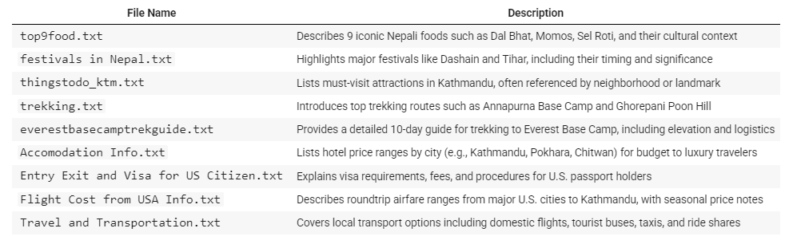
Data Source and knowledge base
This project uses a curated set of 9 manually collected '.txt' files containing domain-specific travel information about Nepal. These database collectively represent the knowledge base used in the RAG system to answer tourist-focused questions.
Each file targets a distinct thematic area relevant to trip planning that includes food, cultural festivals, lodging, trekking, transportation, visa information, and budget.

Slide 4
RAG System Architecture
.txt files
Custom Chunking (file-specific)
FAISS Index: L2 Similarity
User Query to MiniLM Vector
Top k=4 Matching Chunks
FLAN-Base / TinyLLaMA / FLAN Large
RAG Prompt Generator per model
MiniLM Embedding: 384-d vectors
Answer Generation

Slide 5
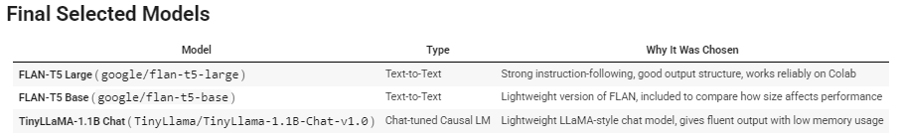
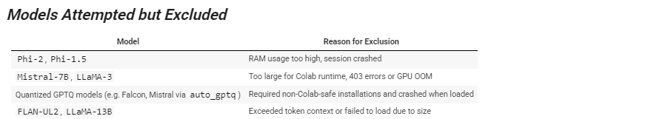
Model Selections

Slide 6
RAG Prompt Generator
Each models in this project requires a slightly different prompt format, depending on its architecture and training style. To ensure fairness and compatibility, we created a generate_rag_response() function that:
Embeds the query using the same MiniLM encoder used for the knowledge base
Retrieves the top 4 most relevant text chunks from the FAISS index
Constructs a model-specific prompt based on the retrieved context
Generates an answer using the chosen LLM pipeline

Slide 7
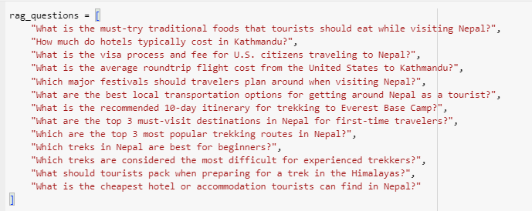
Domain Specific Questions

Slide 8
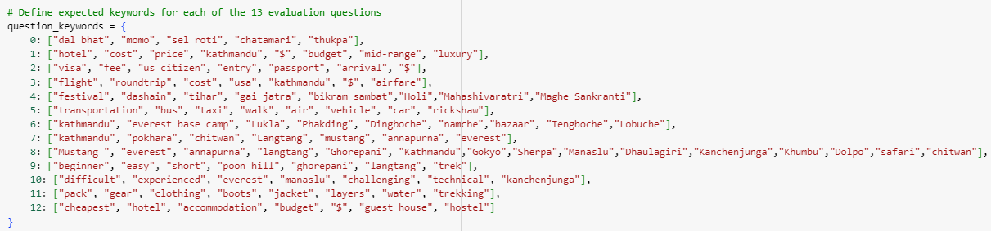
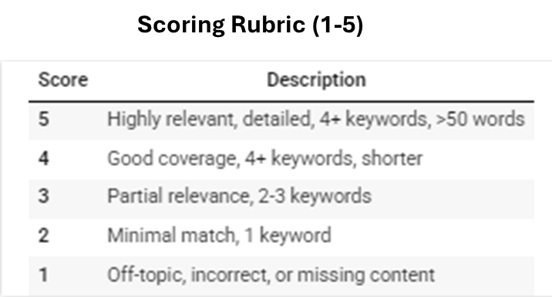
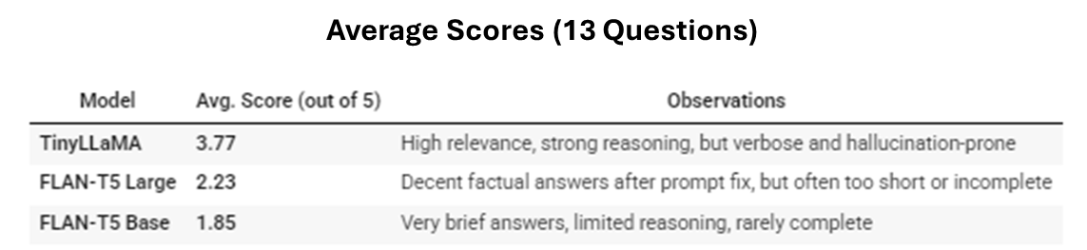
Quant Analysis of LLM outputs

Slide 9
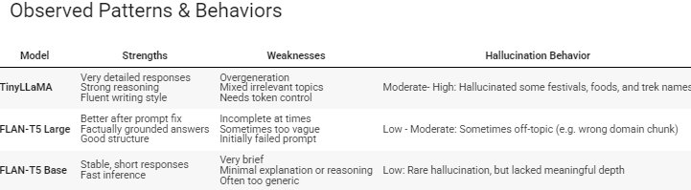
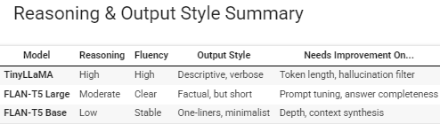
Qualitative Analysis: Hallucination, Reasoning & Patterns

Slide 10

Thank you!
Savyata Regmi

